Slide 1
IPv6 Addressing
John Rullan Cisco Certified Instructor Trainer Thomas A. Edison CTE HS Stephen Lynch Network Architect, CCIE #36243 ABS Technology Architects

Slide 2
IPv6 Addressing Structure
128-bit hexadecimal format (0-9, A-F)
Uses 16-bit hexadecimal number fields separated by colons (:)
Every 4-hexadecimal digits are equivalent to 16-bits.
Consists of 8 hextets/quartets which is the equivalent to 16-bits per-hextet.
2001:0DB8:0001:5270:0127:00AB:CAFE:0E1F /64
- 2001 in hexadecimal is 0010 0000 0000 0001 in binary

Slide 3

IPv6 Addressing Structure
The Site Prefix or Global Routing Prefix is the first 3 hextets or 48-bits of the address. It is assigned by the service provider.
The Site Topology or Subnet ID Is the 4th hextet of the address.
The Interface ID is the last 4 hextets or 64-bits of the address. It can be manually or dynamically assigned using the EUI-64 command. (Extended Unique Identifier)

Slide 4


IPv6 Addressing Structure
First 3 bits are fixed at 001 or 200::/12 (IANA Global Routing Number)
Bits 16-24 identifies the Regional Registry:
- AfriNIC, APNIC, LACNIC, RIPE NCC and ARIN
2001:0000::/23 – IANA
2001:0200::/23 – APNIC (Asia/Pacific Region)
2001:0400::/23 – ARIN (North America Region)
2001:0600::/23 – RIPE (Europe, Middle East and Central Asia)

Slide 5



IPv6 Addressing Structure
Remaining 8-bits up to /32 identifies the ISP.
The 3rd hextet represents the Site/Customer Identifier.
The 4th hextet represent the Site Topology/Subnet ID.
- Allows 65,536 subnets with 18,446,744,073,709,551,616 (18 trillioner) for each subnet.
- Not part of the host address field.

Slide 6

IPv6 Addressing Scheme and Subnets
The Interface ID are the remaining 64-bits of the address.
Can be manually configured or dynamically by using the EUI-64 (Extended Unique Identifier).
The EUI-64 command uses the device 48-bits MAC Address and convert it into 64-bits by adding FF:FE in the middle of the address.
The first (network) and last (broadcast) address may be assigned to an interface. An interface may contain more than one IPv6 address.
There are no broadcast addresses, multicast is used instead.

Slide 7
IPv6 Addressing Scheme and Subnets
IPv6 uses the same method as IPv4 to subnet their addresses.
/127 gives you 2 addresses.
/124 gives you 16 addresses
/120 gives you 256 addresses
The first address in a network consists of all 0's and the last address consists of all F's.
It’s recommended for simplicity and design purposes to use /64 everywhere. Using anything less than /64 could potentially break IPv6 features and cause increased design complexity.

Slide 8
Leading Zeroes and Double Colons (::)
Leading 0s (zeroes) in any 16-bit section can be omitted.
Address before omission:
2001:0DB8:0001:5270:0127:00AB:CAFE:0E1F /64
Address after omission:
2001:DB8:1:5270:127:AB:CAFE:E1F /64
This rule applies only to leading 0s; if trailing 0s are omitted, the address would be vague.

Slide 9

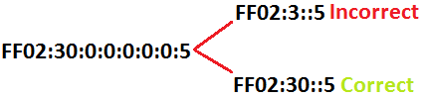
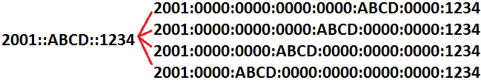
Leading Zeroes and Double Colons (::)
A Double Colons or Compressing Zeroes can be used to shorten an IPv6 address when one or more hextets consist of all 0s.
Double Colons can only be used to compress a single contiguous 16-bits blocks. You cannot use double colons to include part of a block.
Double Colons can only be used once in an address, if it's used more than once the address could be ambiguous

Slide 10
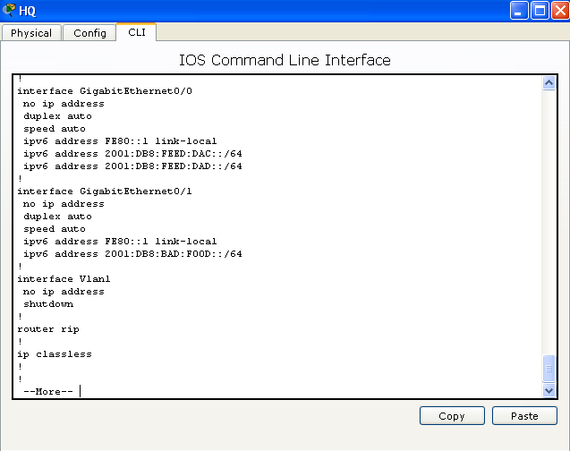
Types of IPv6 Addresses
Unicast Address
Uniquely identifies a single
interface on an IPv6 device.
A packet sent to a unicast
address destination travels
from one host to the destination
host.
An interface may have more than
one IPv6 address or an IPv6 and an
IPv4 addresses which is referred as
"Double Stack".
When mistakes are made on
Entering an address to the IPv6
interface, the user must issue the
no ipv6 address command before
entering the correct one or the
address will remain on the interface.
(see figure)

Slide 11
Types of IPv6 Addresses (cont'd)
Multicast Address
A Multicast address identifies a group of interfaces.
All Multicast address are identified by their reserved address range FF00::0/8
A packet sent to a multicast address is delivered to all devices that are identified by that address.
Anycast Address
A unicast address can be assigned to several interfaces/devices.
A packet sent to an Anycast address goes only to the nearest member of the group, according to the routing protocols measures of distance.
Anycast is described as a cross between a Unicast and Multicast.
The difference between an Anycast and Multicast is that in Anycast packet is only delivered to a single device, while Multicast send it to multiple devices.
Protocol IPv4 Multicast IPv6 Multicast
OSPF (Router) 224.0.0.5 FF02::5
OSPF (DR/BDR) 224.0.0.6 FF02::6
RIPv2 224.0.0.9 FF02::9
EIGRP 224.0.0.10 FF02::A

Slide 12
Types of IPv6 Addresses (cont'd)
Link-Local Address
Link-Local address are designed for use on a single local link.
Link-Local address are automatically configured on all interfaces.
The prefix used for a Link-Local address is FE80::X/10.
Routers do not forward packet with a destination and source address containing a link-local address.
Loopback Address
Similar function to IPv4 127.0.0.1 address
The Loopback address is 0:0:0:0:0:0:0:1 or may be simplify by using double colons as ::1.
It is used by a device to send a packet to itself
Representation IPv6 Loopback Address
Preferred 0000:0000:0000:0000:0000:0000:0000:0001
No Leading 0’s 0:0:0:0:0:0:0:1
Compresses ::1

Slide 13
IPv6
IPv4
128-bits address containing global routing prefix, subnet ID and interface ID.
10^33 Kvintilliard (Decilion)
Uses a hexadecimal format ranging from 0-9, A-F.
Maximum Transmission Unit up to 1280 bytes.
Network address and broadcasts address can be assigned to an interface or end device.
Native IPsec encryption
32-bits addressing scheme containing a host and a network portion.
10^4,2 Milliarder
Use binary format between 0 and 1.
Maximum Transmission Unit up to 576 bytes.
Network address and broadcasts address cannot be assigned to an interface or end device.
VPN technologies must be used to encrypt IPv4 packets.

